Slide 1

PHONE DIRECTORY PROJECT USING DOUBLY LINKED LIST
-3501 Dhruvi -3506 Aishani -3512 Kedar

Slide 2
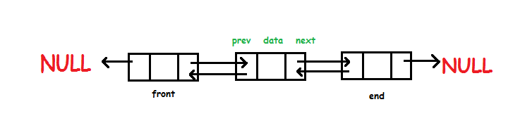
INTRODUCTION
Doubly Linked List is a variation of Linked list in which navigation is possible in both ways i.e. forward and backward easily as compared to Single Linked List. Following are the important terms to understand the concept of doubly linked list.
Link − Each link of a linked list can store a data called an element.
Next − Each link of a linked list contains a link to the next link called Next.
Prev − Each link of a linked list contains a link to the previous link called Prev.
LinkedList − A Linked List contains the connection link to the first link called First and to the last link called Last.

Slide 3
Introduction to phonebook directory
Phone book management system is based on the concept to generate personal or an organization contact records and to add their records and update it.
Adding new records ,listing them and updating, search for contacts saved and deleting the phonebook records are the basic functions which makes up the main menu of phone book management system.
Personal information such as Name ,Email Id, phone number are asked while adding a record into the phone book.
These records can then be modified , listed, searched for and removed.

Slide 4
Contents in a phonebook
Why Doubly Linked List?
Subscriber names are generally listed in alphabetical order, together with their postal or street address and telephone number.
A telephone directory may also provide instructions: how to use the telephone service, how to dial a particular number, be it local or international, what numbers to access important and emergency services, utilities, hospitals, doctors, and organizations who can provide support in times of crisis.
It may also have civil defense or emergency management information.
The most common reason to use a doubly linked list is because it is easier to implement than a singly linked list.
While the code for the doubly linked implementation is a little longer than for the singly linked version, it tends to be a bit more “obvious” in its intention, and so easier to implement and debug.
Doubly Linked List is an ordered collection of elements of same type, which are connected to each other using pointers. Hence it would make accessibility easy
In case of dll, a new element is stored at the first free and available memory location, with only a single overhead step of storing the address of memory location in the previous node of linked list. Hence, Insertion and Deletion operations are fast in doubly linked list.

Slide 5
Time Complexity
The time complexity is the computational complexity that describes the amount of computer time it takes to run an algorithm.
Since an algorithm's running time may vary among different inputs of the same size, one commonly considers the worst-case time complexity, which is the maximum amount of time required for inputs of a given size.
Access
By Index: O(N)
Insert
Before first node :O(1)
After given node :O(1)
After last node :O(1)
Delete
The first node: O(1)
A given node: O(1)
The last node: O(1)
Search
A given value: O(N)

Slide 6
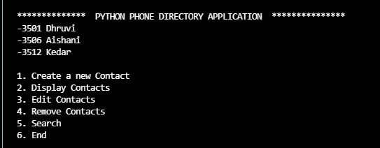
So basically these are the 6 main types of functions that the phonebook does on the contacts. Let’s have a look at them one by one.

Slide 7
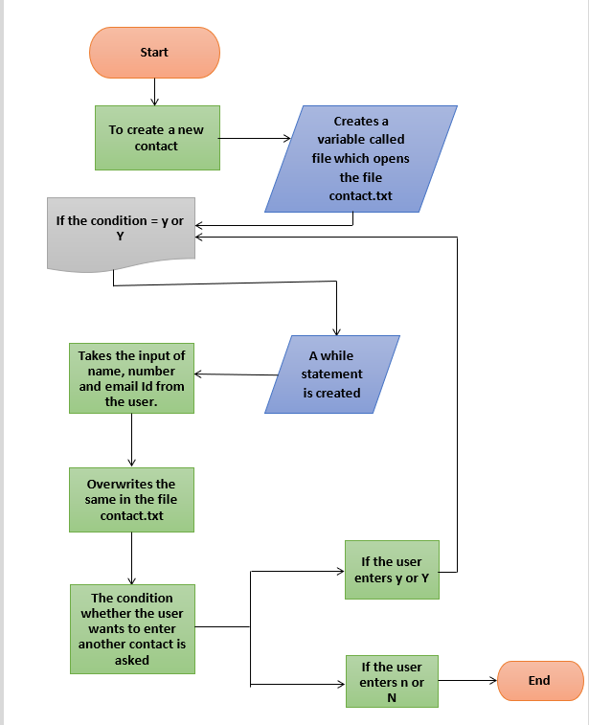
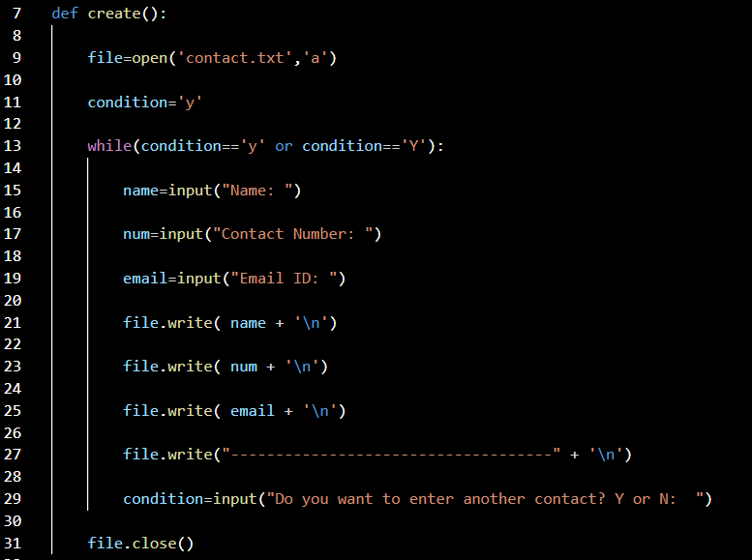
Creating a new contact

Slide 8
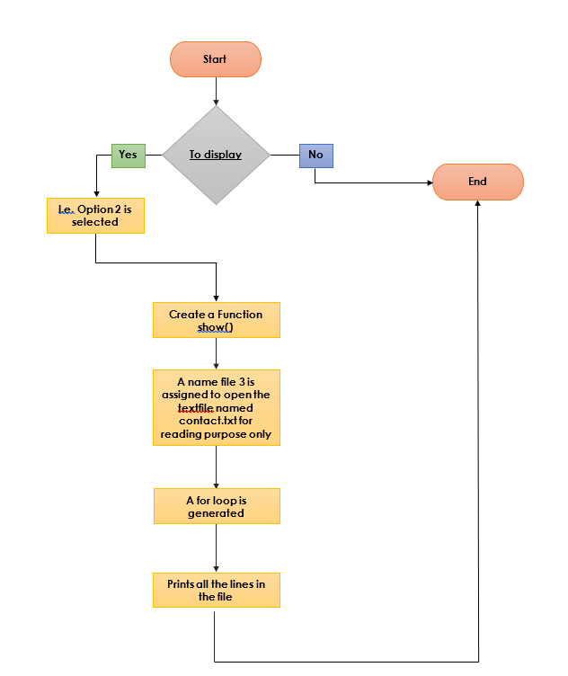
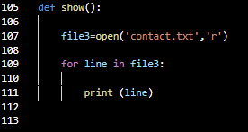
Display
Display shows all the Contact details that are entered.(D)
It opens the contact.txt file and shows the user entered details for the phone book

Slide 9
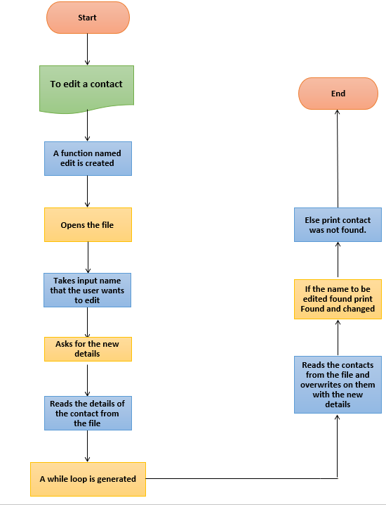
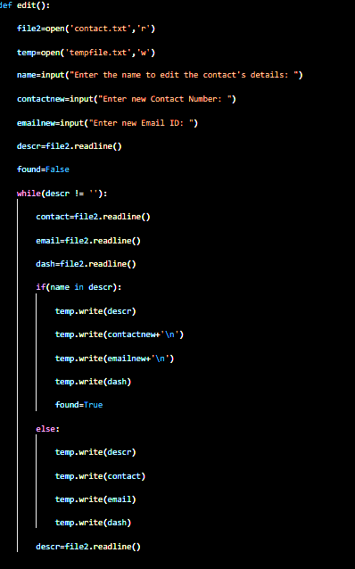
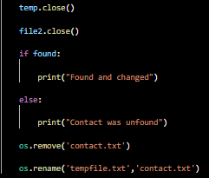
Edit

Slide 10
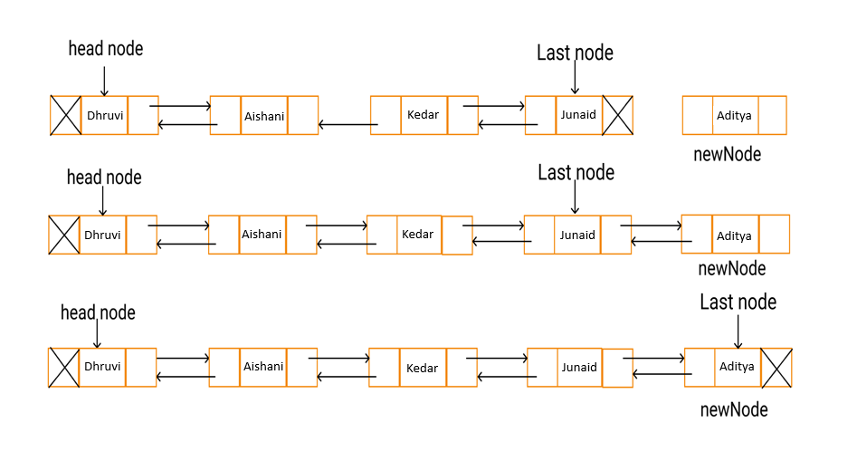
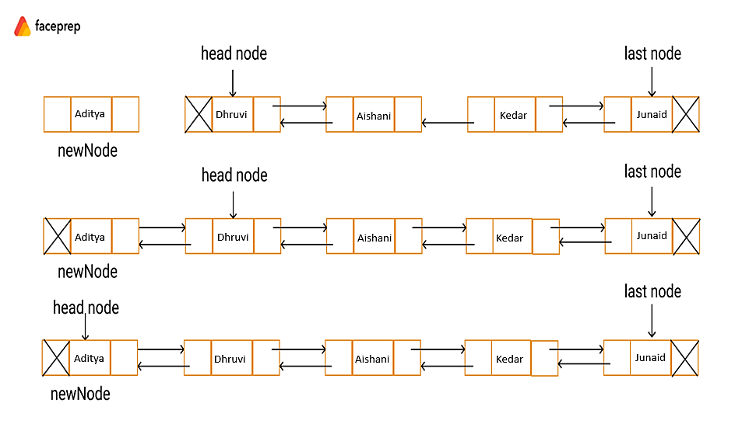
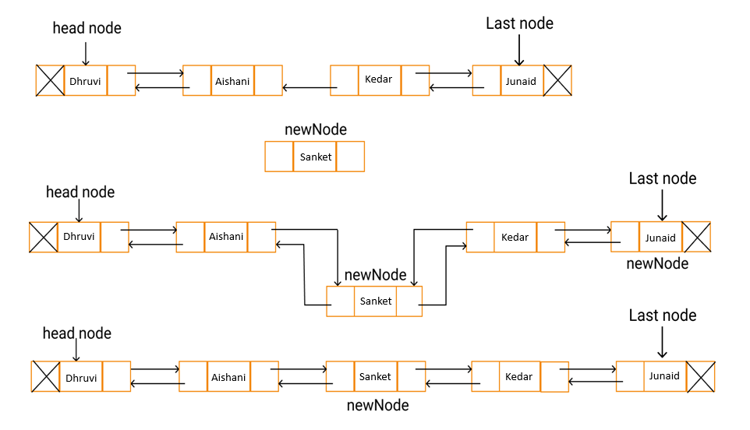
INSERTION
01.
02.
03.
Insertion at the beginning of the doubly linked list
Insertion at the end of the doubly linked list
Insertion at a given position in a doubly linked list

Slide 11
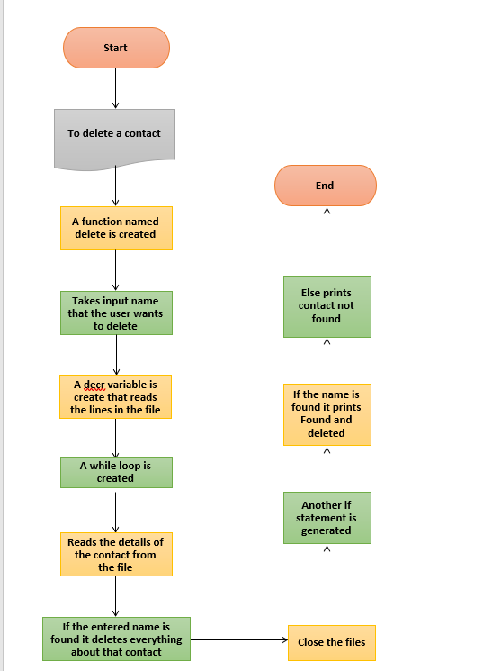
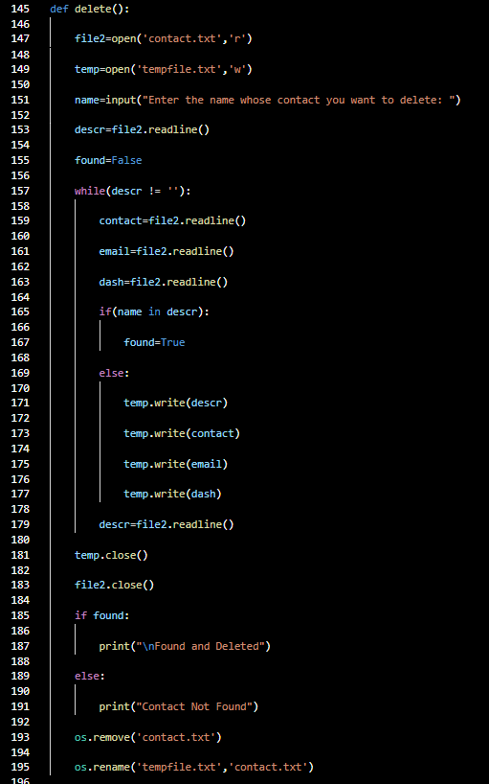
Deletion

Slide 12
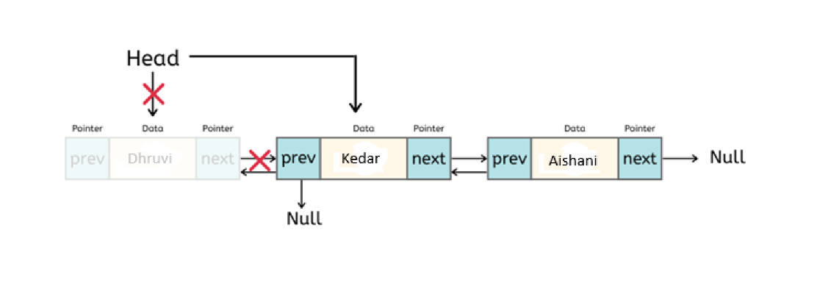
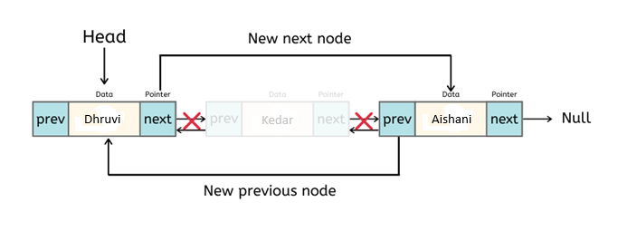
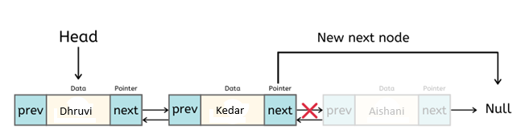
Deletion
Deletion at beginning
Deletion at middle
Deletion at the end

Slide 13
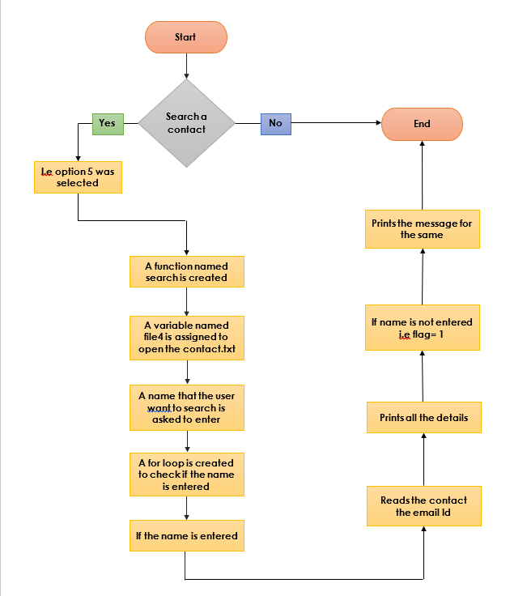
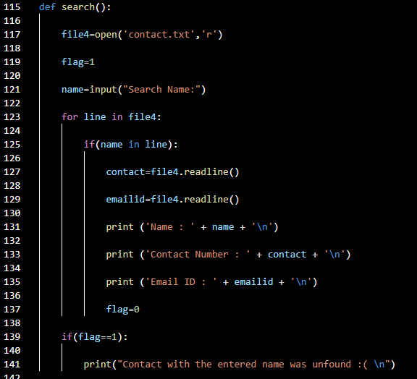
Searching

Slide 14
Let’s Dive into our Phone Book!!!

